Slide 1


Enabling a data-informed public sector
From hype to action using
the Big Data Test Infrastructure (BDTI)
EC-BDTI-PILOTS@ec.europa.eu
DG CNECT
Directorate-General for Communications
Networks, Content and Technology
DG DIGIT
Directorate-General
for Informatics
Notes:
Option 2: intro slide

Slide 2








Public Sector Information and the role of Data analytics
Data is everywhere and growing at an unprecedent pace.
  - Big Data: 3V - Volume, Variety, Velocity
Data is a key ingredient for services, products, and effective policy making.
There is an ambition to create a single European market for data and make more data available through powerful and trustworthy infrastructures and technologies, in line with EU values and regulations, to support citizens, public sector and companies.
  Learn more about the Digital Europe Programme: https://digital-strategy.ec.europa.eu/en/activities/digital-programme
Notes:
Learn more about the Digital Europe Programme: https://digital-strategy.ec.europa.eu/en/activities/digital-programme

Slide 3




What is the Big Data Test Infrastructure (BDTI)?​
BTDI: Not only for big data, but for all public sector information
Six months free* of charge service
for the EU public administrations
Ready-to-use data analytics stack and support
Cloud platform based on
open-source tools
To help the public sector to derive insights from its data and accelerate transition towards data-driven decision making
  * The cost of the pilot project must fit within the funding boundaries of the BDTI pilot budget

Slide 4
Big Data Test Infrastructure Objectives ​
Objectives
Increase the easy accessibility, interoperability, quality and usability of public sector information in compliance with the requirement of the Open Data Directive
Boost the re-use and combination of open public data across the EU for the development of information products and services, including AI applications
High Value Datasets – Open Data Directive​
Testing Business-to-Government (B2G) data sharing collaborations for the public good​
Data Space Support Centre: explore and experiment with your data*
BDTI provides a safe testing environment to run big data experiments for data space customers
* https://joinup.ec.europa.eu/collection/semic-support-centre/data-spaces
Notes:
Learn more about the Digital Europe Programme: https://digital-strategy.ec.europa.eu/en/activities/digital-programme

Slide 5
About the Big Data Test Infrastructure (BDTI)
The BDTI is funded by the Digital Europe Programme (DEP)
focused on bringing digital technology to businesses, citizens and public administrations.
The DEP provides strategic funding in five crucial areas:
High performance computing
Cybersecurity
Artificial intelligence
(Cloud, data and AI)
Advanced digital skills
Deployment and wide use of digital technologies
  Learn more about the Digital Europe Programme: https://digital-strategy.ec.europa.eu/en/activities/digital-programme
Notes:
Learn more about the Digital Europe Programme: https://digital-strategy.ec.europa.eu/en/activities/digital-programme

Slide 6










Open-source tools to support your data journey
1. Collection
2. Processing
3. Analysis
4. Visualization
5. Decision-Making
Orchestration
Data Lake
Database
Advanced Processing Engines
Development Environments
Notes:
In few words, BDTI is an enabler for a data driven public sector, a play ground free and ready to use data analytics platform, based on open source tools and cloud infrastructure, where EU public administration can play with data, test their ideas and implement their pilot project for a duration of six months.
In particular, BDTI wants to Support public administrations they maybe don’t have dedicated resources and infrastructure, providing them the necessary onboarding services and ready to use tools to experiment data-driven products for the public good.
boost public administration at each level, local, regional and national, , in testing and developing data services and products with particular focus on
Reusing public sector information in compliance with the Open data Directive and the legislative framework on data
Experiment in the context of the EU data strategy,
specifically within the different data spaces
foster data collaboratives and data for good with Business to Government

Slide 7
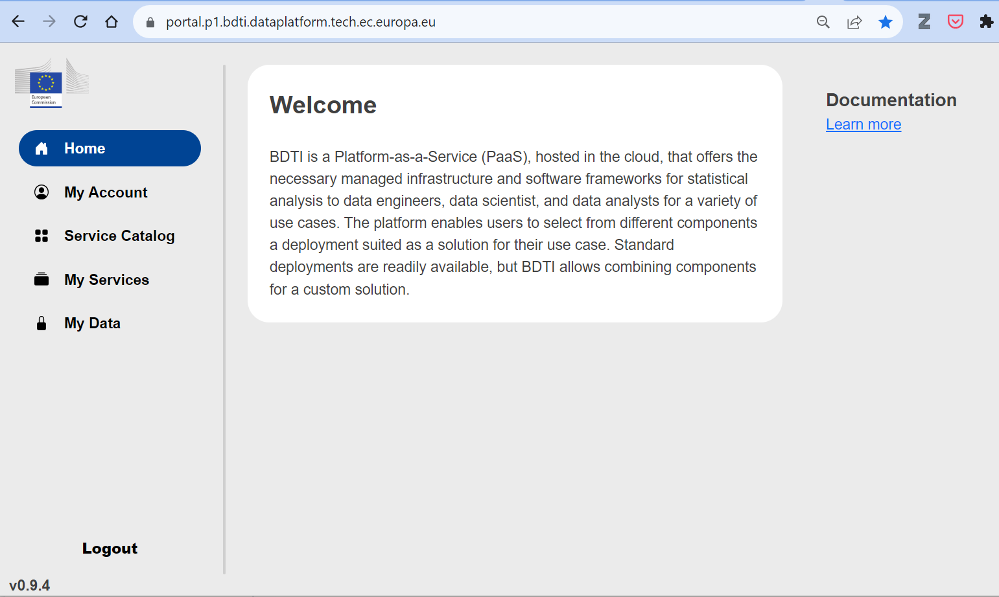
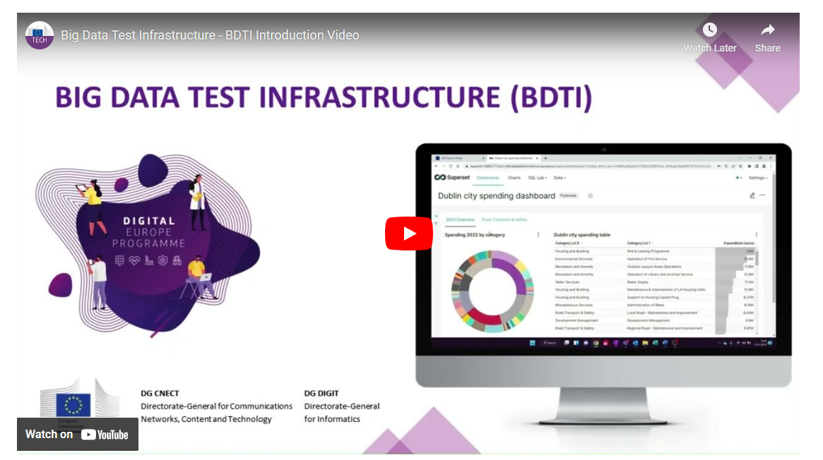
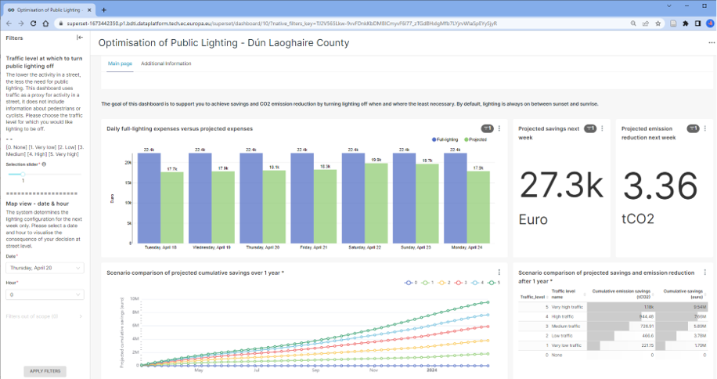
The BDTI portal
https://youtu.be/fdzNCB1CVUM
Notes:
In few words, BDTI is an enabler for a data driven public sector, a play ground free and ready to use data analytics platform, based on open source tools and cloud infrastructure, where EU public administration can play with data, test their ideas and implement their pilot project for a duration of six months.
In particular, BDTI wants to Support public administrations they maybe don’t have dedicated resources and infrastructure, providing them the necessary onboarding services and ready to use tools to experiment data-driven products for the public good.
boost public administration at each level, local, regional and national, , in testing and developing data services and products with particular focus on
Reusing public sector information in compliance with the Open data Directive and the legislative framework on data
Experiment in the context of the EU data strategy,
specifically within the different data spaces
foster data collaboratives and data for good with Business to Government

Slide 8
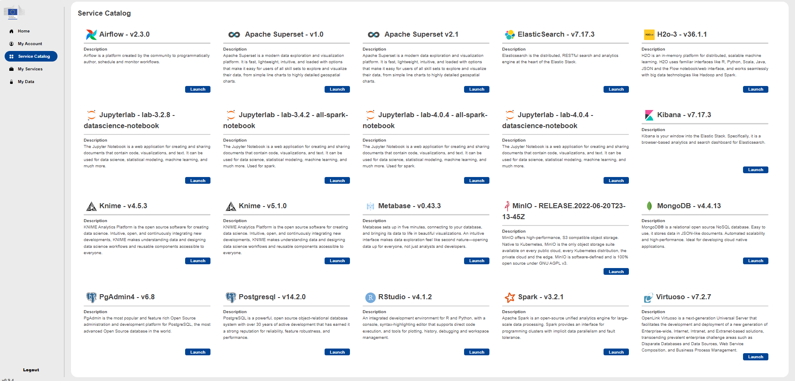
100% ❤️
open-source components
The BDTI portal
Notes:
In few words, BDTI is an enabler for a data driven public sector, a play ground free and ready to use data analytics platform, based on open source tools and cloud infrastructure, where EU public administration can play with data, test their ideas and implement their pilot project for a duration of six months.
In particular, BDTI wants to Support public administrations they maybe don’t have dedicated resources and infrastructure, providing them the necessary onboarding services and ready to use tools to experiment data-driven products for the public good.
boost public administration at each level, local, regional and national, , in testing and developing data services and products with particular focus on
Reusing public sector information in compliance with the Open data Directive and the legislative framework on data
Experiment in the context of the EU data strategy,
specifically within the different data spaces
foster data collaboratives and data for good with Business to Government

Slide 9



Who is BDTI for ?
European Public Administrations
All European Public Administrations at local, regional and national level
can independently apply for a BDTI pilot project
Partnerships with academia and the private sector
Academia (master, PhD students) and startups and companies (GovTech sector) can apply if they are collaborating with a public administration
Notes:
In few words, BDTI is an enabler for a data driven public sector, a play ground free and ready to use data analytics platform, based on open source tools and cloud infrastructure, where EU public administration can play with data, test their ideas and implement their pilot project for a duration of six months.
In particular, BDTI wants to Support public administrations they maybe don’t have dedicated resources and infrastructure, providing them the necessary onboarding services and ready to use tools to experiment data-driven products for the public good.
boost public administration at each level, local, regional and national, , in testing and developing data services and products with particular focus on
Reusing public sector information in compliance with the Open data Directive and the legislative framework on data
Experiment in the context of the EU data strategy,
specifically within the different data spaces
foster data collaboratives and data for good with Business to Government

Slide 10




Why use BDTI?
Benefit of six months free of charge, including advisory and technical support
Experiment with data analytics using high performance infrastructure that leverages the power of the elastic cloud​
Receive guidance to move from a pilot to a production-ready process
Test your idea → Extract value → Create knowledge
Notes:
In few words, BDTI is an enabler for a data driven public sector, a play ground free and ready to use data analytics platform, based on open source tools and cloud infrastructure, where EU public administration can play with data, test their ideas and implement their pilot project for a duration of six months.
In particular, BDTI wants to Support public administrations they maybe don’t have dedicated resources and infrastructure, providing them the necessary onboarding services and ready to use tools to experiment data-driven products for the public good.
boost public administration at each level, local, regional and national, , in testing and developing data services and products with particular focus on
Reusing public sector information in compliance with the Open data Directive and the legislative framework on data
Experiment in the context of the EU data strategy,
specifically within the different data spaces
foster data collaboratives and data for good with Business to Government

Slide 11





Who used it already?
Generalitat Valenciana needed a solution to sift through vast scientific clinical articles from various sources like PubMed.gov and COVID-19-related publications. Their challenge was to extract valuable insights and knowledge from this immense volume of data.
Advanced data visualization and text mining tools to help extract knowledge contained in the documents,
supporting clinicians and managers in their clinical practices and day-to-day work.
The European Blood Alliance and DG SANTE embarked on a collaborative effort to establish a comprehensive open-access platform in Europe. This initiative aimed to collect crucial data for a focused study on COVID-19 convalescent plasma therapy. The challenge was to identify the most effective conditions for this treatment, utilizing data analysis to make informed decisions and streamline research efforts.
A ready-to-use, virtual environment in which data collected through a custom-built website are ingested and anonymized, to be then analyzed with advanced data visualization and analytical tools. Initially, only donation data were processed, then the scope was increased to capture the end-to-end of blood plasma, from donation to patient/clinical trial.
The Municipality faced the complex task of correlating diverse datasets within the city. Their objective was to understand the movement patterns of people across different districts over time. This data analysis challenge was essential for gaining insights into mobility trends and for redesigning services to promote cultural activities and events effectively.
Predictive, descriptive and time-series analysis on multiple datasets collected before, during and after the Covid-19 pandemic such as: public Wi-Fi sensors, parking and geo-referenced data of people movements (i.e., tourists).
Notes:
In few words, BDTI is an enabler for a data driven public sector, a play ground free and ready to use data analytics platform, based on open source tools and cloud infrastructure, where EU public administration can play with data, test their ideas and implement their pilot project for a duration of six months.
In particular, BDTI wants to Support public administrations they maybe don’t have dedicated resources and infrastructure, providing them the necessary onboarding services and ready to use tools to experiment data-driven products for the public good.
boost public administration at each level, local, regional and national, , in testing and developing data services and products with particular focus on
Reusing public sector information in compliance with the Open data Directive and the legislative framework on data
Experiment in the context of the EU data strategy,
specifically within the different data spaces
foster data collaboratives and data for good with Business to Government

Slide 12







How to apply: a fast and simple process
Get familiar with the BDTI service on our website
Meet with us to elaborate on your use case
Your test environment is set up
You can start piloting and create value!
Submit your pilot request (template) by email
EC-BDTI-PILOTS@ec.europa.eu
Define your data analytics use case using our BDTI Canva and then fill in the template request form
(see website)
Pilot Project is approved if:
Brings value, can be done in 6 months, sufficient resources
available
(skills, team, data)
Notes:
Mention the number of pilots we had until now

Slide 13





Thank you for your attention!
Are you working for a public administration in need of infrastructure for data analytics? Get in touch
EC-BDTI-PILOTS@ec.europa.eu​
BDTI website
BDTI's Joinup page
BDTI's newsletter

Slide 14
Links and resources
https://big-data-test-infrastructure.ec.europa.eu/
https://code.europa.eu/bdti/bdti-demonstrator
https://commission.europa.eu/publications/interoperable-europe-act-proposal_en
https://commission.europa.eu/strategy-and-policy/priorities-2019-2024/europe-fit-digital-age/european-data-strategy_en
https://digital-strategy.ec.europa.eu/en/policies/legislation-open-data
https://digital-strategy.ec.europa.eu/en/policies/data-governance-act
https://digital-strategy.ec.europa.eu/en/policies/european-approach-artificial-intelligence
https://digital-strategy.ec.europa.eu/en/activities/digital-programme
https://dssc.eu/wp-content/uploads/2023/03/DSSC-Data-Spaces-Glossary-v1.0.pdf
https://digital-strategy.ec.europa.eu/en/library/staff-working-document-data-spaces
https://ec.europa.eu/commission/presscorner/detail/en/ip_22_1113
https://eur-lex.europa.eu/legal-content/EN/TXT/?uri=celex%3A32019L1024
https://joinup.ec.europa.eu/collection/egovernment/solution/big-data-test-infrastructure-bdti

