Slide 1
Enabling a data-driven public sector
From hype to action using
the Big Data Test Infrastructure (BDTI)
DG CNECT
Directorate-General for Communications
Networks, Content and Technology
DG DIGIT
Directorate-General
for Informatics
Notes:
Option 2: intro slide

Slide 2
What is the Big Data Test Infrastructure (BDTI)?​
BTDI: Not only for big data, for public sector information in general
Six months free of charge service
for the EU public sector
Ready-to-use data analytics stack and support
Cloud platform based on
open-source tools
To help the public sector to derive insights from its data and accelerate transition towards data- driven decision making

Slide 3
Why use the BDTI ?
Benefit of six months free of charge service, including advisory and technical support for the duration of the pilot
Experiment with data analytics using high performance infrastructure that leverages the power of the elastic cloud​
Receive guidance to move from a pilot to a production-ready process – EXIT package ready to use​
Extract value

Slide 4
Who is the BDTI for?
European Public Administrations
All European Public Administrations at local, regional and national level can independently apply for a BDTI pilot project
Ecosystem with academia and private sector
Academia, spin-off, and startups can apply for pilot projects if there is a clear collaboration with a public administration (local, regional, national):
PhD students
Master thesis
GovTech startups
Notes:
Interested in data-driven decision-making
Experiment with data analytics open-source tools
Move from hype to action

Slide 5
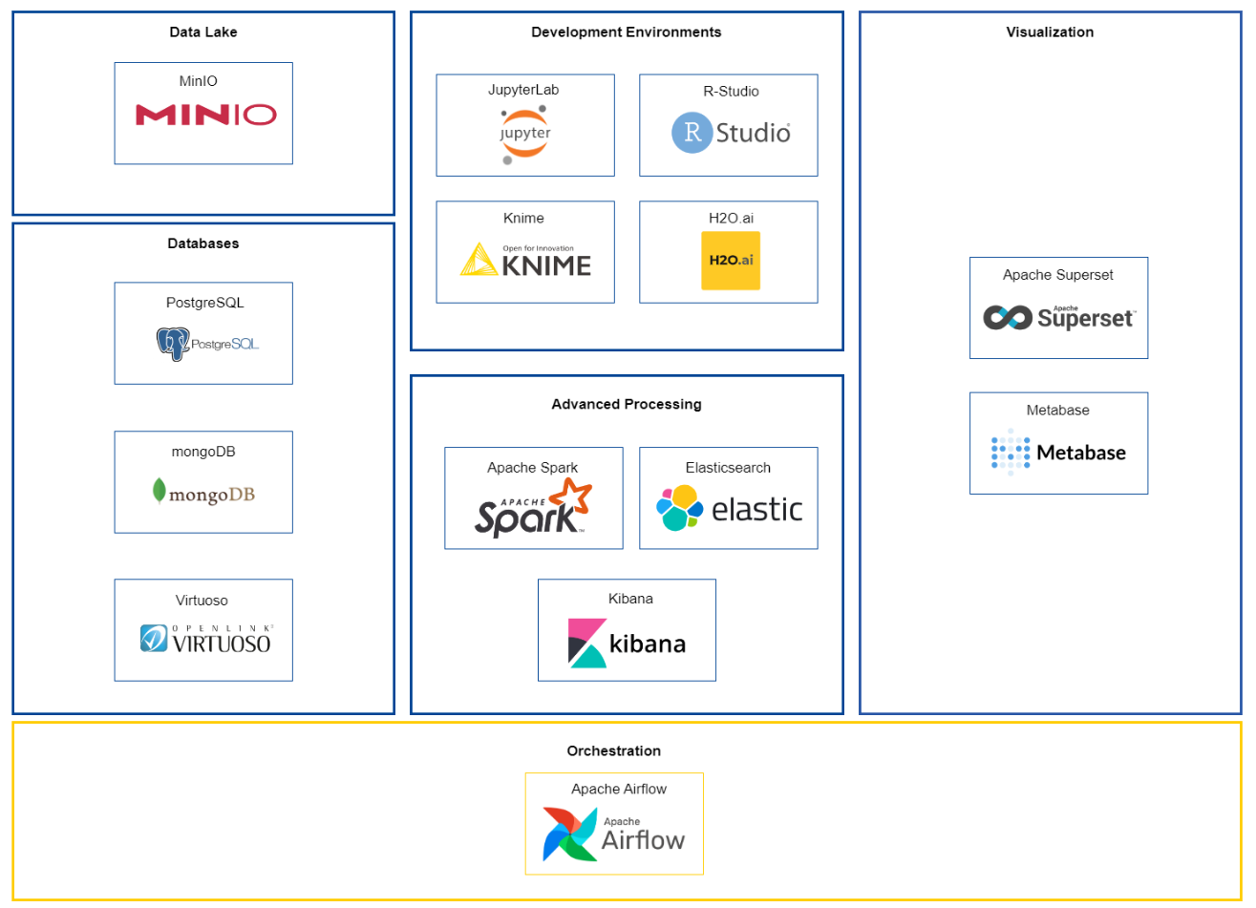
BDTI's Data Analytics Stack
https://big-data-test-infrastructure.ec.europa.eu/service-offering_en

Slide 6
Who used it already?
The Valencian Pharmacy and Health Products authority (Direcciòn General de Farmacia y Productos Sanitarios - DGFyPS) (Spain) used text mining to analyze and synthesize the huge quantity of existing scientific evidence and regulation documentation on COVID-19.
The European Blood Alliance in collaboration with the EU Commission (DG SANTE) to create and manage an EU-wide, open-access platform gathering data on COVID-19 convalescent plasma therapy.
The city of Florence (Italy) to understand COVID-19 impact and to ensure lockdown measures were lifted in a responsible and controlled manner.

Slide 7
Who used it already?
CONSELLERIA DE SANITAT (CS) - Text Mining
Conselleria de Sanitat, the Health Public Administration of the Comunidad Valenciana Regional Government, needed a tool capable of analysing and extract knowledge from the huge quantity of scientific clinical articles coming from different sources (i.e. PubMed.gov, Covid-19 related clinical articles).
Advanced data visualization and text mining tools to help extracting knowledge contained in the documents, supporting clinicians and managers in their clinical practices andd day-to-day work in fighting the virus.
EU CONVALESCENT PLASMA DATABASE – Data sharing
The European Blood Alliance is working together with the European Commission (DG SANTE) to create and manage an EU-wide open-access platform that collects data to support a study on Covid-19 convalescent plasma therapy. The aim of the study is to assess in which conditions the convalescent plasma treatment is most effective, in order to take data driven decisions on the therapy and focus the efforts of the research in the most promising directions.
A ready-to-use, virtual environment in which data collected through a custom-built website are ingested and anonymized, to be then analyzed with advanced data visualization and analytical tools. Initially, only donation data were processed, then the scope was increased to capture the end-to-end of blood plasma, from donation to patient/clinical trial.
CITY OF FLORENCE – Mobility data
The main goal of the Municipality is to perform a cross correlation between the multiple datasets available within the city to understand how people were and are moving between the different districts, to then derive precious insights about mobility the most and about how services can be redesigned to foster cultural activities and events.
Predictive, descriptive and time-series analysis on multiple datasets collected before, during and after the Covid-19 pandemic such as: public Wi-Fi sensors, parking and geo-referenced data of people movements (i.e., tourists).

Slide 8
Pilot 4 - Semantic Knowledge Graphs for Distributed Data Spaces: the Public Procurement Pilot Experience
https://iswc2022.semanticweb.org/index.php/accepted-papers/
Notes:
Mention the number of pilots we had until now

Slide 9
How to start:
Get familiar with the BDTI service on our website
Meet with us to elaborate on your use case
Your test environment is set up
You can start piloting and create value!
Define your data analytics use case using our template (see website)
Submit your pilot request (template) by email
Pilot Project is approved if:
brings value,
can be done in 6 months,
sufficient resources available (skills, team, data)
Notes:
Mention the number of pilots we had until now

Slide 10
Contact details
To submit your application for the BDTI or for more information, do not hesitate to contact us:
EC-BDTI-PILOTS@ec.europa.eu​
For additional information please visit our website:
Big Data Test Infrastructure (BDTI) (europa.eu)
Notes:
Mention the number of pilots we had until now

